Slide 1

Exploring Social Contextual Influences on Healthy Eating using Big Data Analytics
Vijaya Kumari Yeruva
University of Missouri Kansas City
Sidrah Junaid
University of Missouri Kansas City
Dr.Yugyung Lee
University of Missouri Kansas City

Slide 2

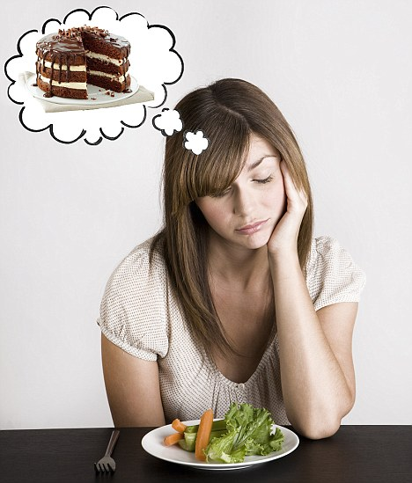
Motivation
In the chicken-or-the-egg problem of food and mood, do the moods hatch the foods, or do the foods hatch the moods?
https://www.theatlantic.com/health/archive/2014/03/our-moods-our-foods/284238/

Slide 3
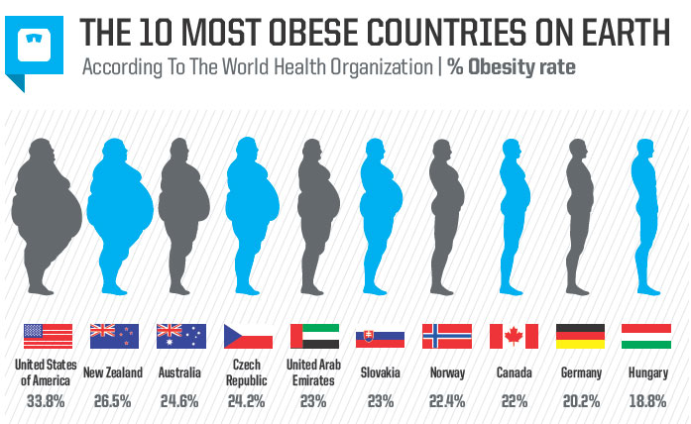
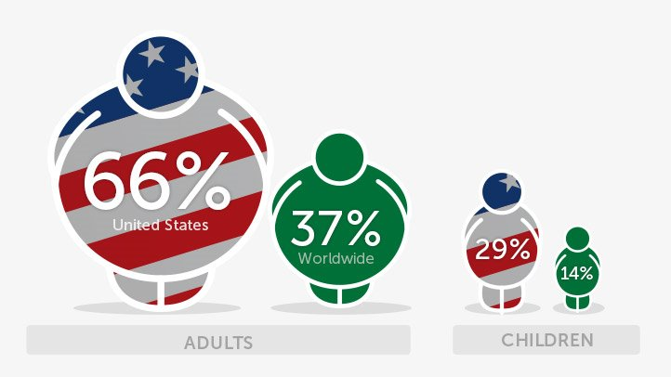
Motivation
An alarming proportion of the US population is overweight: 2/3 of US adults are overweight, and 1/3 of those overweight are obese.

Slide 4
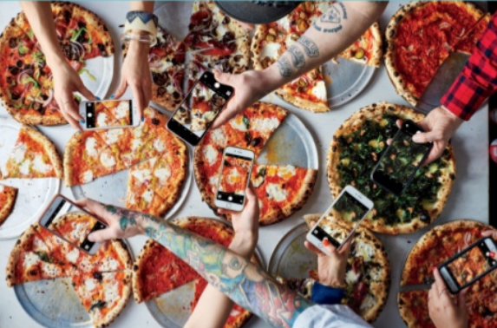
Motivation
63% of 13-32 yrs. old have posted a photo on social media of food or drinks they were having
3x
The amount of times a week a millennial will, on average, post a photo of food on their social media
47% of 13-32 yrs. old consider themselves ‘foodies’
#foodporn: The growing influence of social food |Ypulse

Slide 5
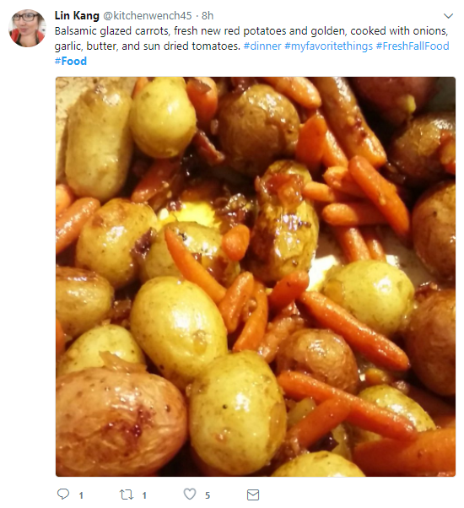
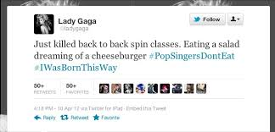

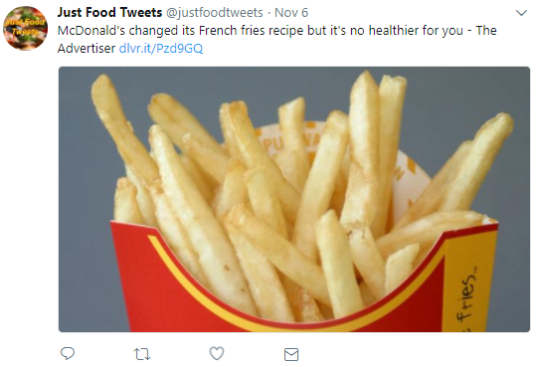

Motivation
Healthy food
Healthy food
Unhealthy food
Unhealthy food
Image

Slide 6
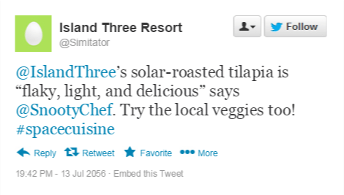
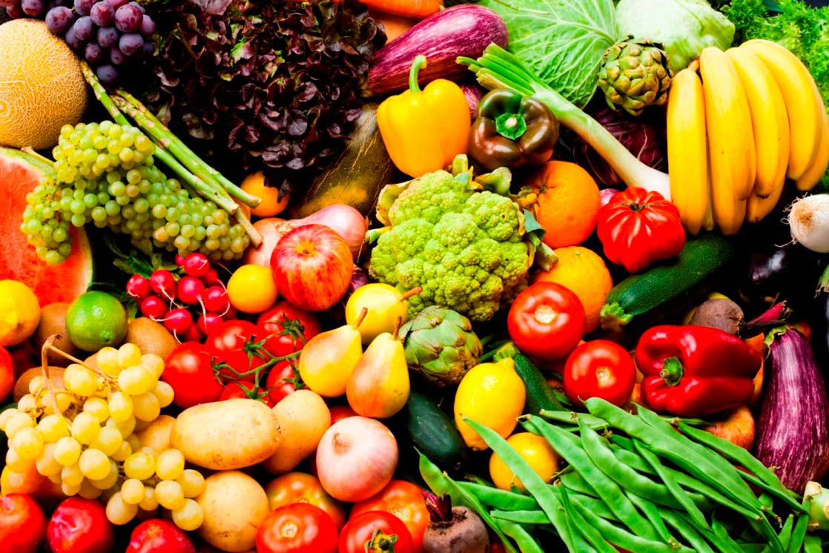
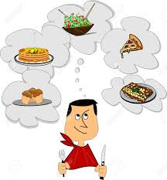
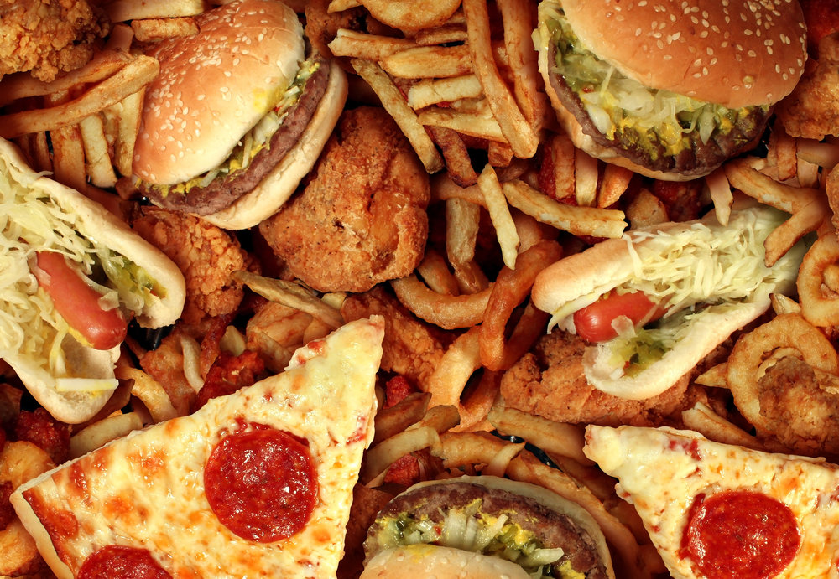


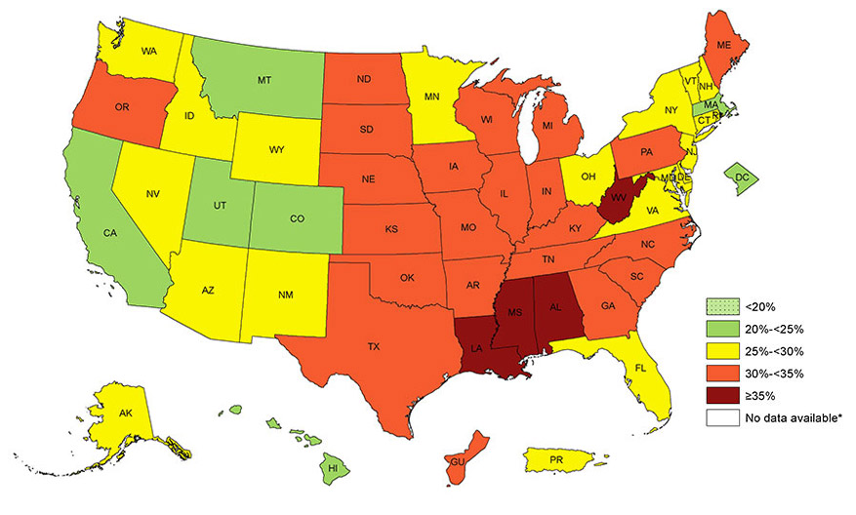
Hypothesis
What kind of food are the indicator of healthy dieting?
Is this particular tweet a healthy dieting tweet or not?
Are there any geographic tendencies in obesity problem
Does a tweet is positive or negative about dieting?

Slide 7
Related Work: Social Media and Machine Learning
Tweet Text Classification
Reference | Objective | Datasets | Method Used | Result(Accuracy)
Nguyen et al.2016 | Twitter Analysis for well being and health behavior | Machine and manually labelled tweets | Machine Learning Algorithm | 78% happy,0.54 F-Score; 83% happy,0.86 F-Score
Eichstaedt et al.2015 | Twitter Analysis for cardiovascular mortality with physiological factors | 1,347 U.S. counties for AHD mortality rates; 50,000 tweeted words | Used regression model | Twitter based model outperformed the prediction model
Visual Food Recognition
Chokr et al. 2017 | Predicting the amount of calories from food images | Pittsburgh fast-food image dataset | extract raw features from food images | 93% error reduction in the case of RGB
Liu et al. 2017 | A real-time food recognition system for dietary assessment | ImageNet, UEC-256 and Food101 | CNN-based Food Image Analysis Algorithms | 94% of top 5 accuracy for Food101 dataset 94.6% of top 5 accuracy for UEC-256 dataset
Singla et al. 2016 | Food/non-food classiﬁcation | Food-5K, Food-11 and Instagram Food/Nonfood Dataset (IFD) | Used a pre-trained CNN GoogLeNet model | 99.2%
Farinella et al. 2016 | Food image processing | UNICT-FD1200 | SIFT, Bag of Textons, Anti-textons | 85.82% accuracy

Slide 8
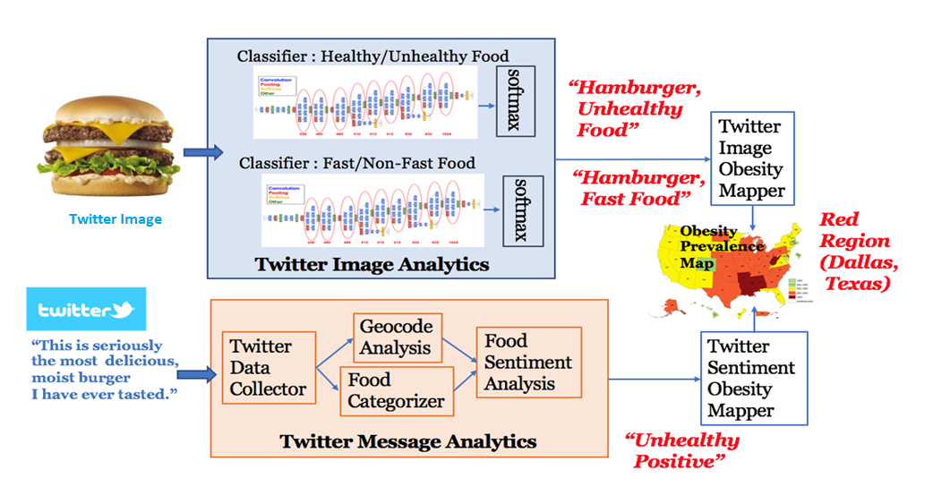
BiDAF: Big Data Analytics Framework

Slide 9

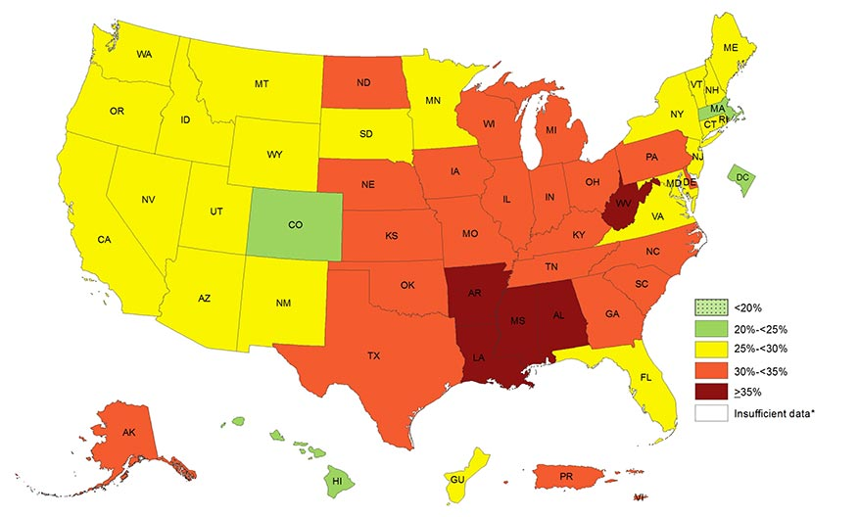
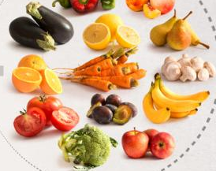
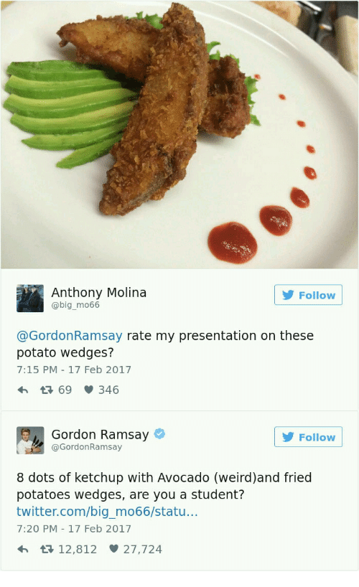


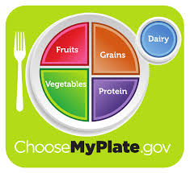
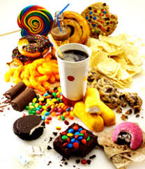
Tweet Text Classification
Tweet collection
Filter tweets
Sentiment analysis by VADER
Classify tweets into Healthy/Unhealthy
comp.social.gatech.edu/papers/icwsm14.vader.hutto.pdf

Slide 10

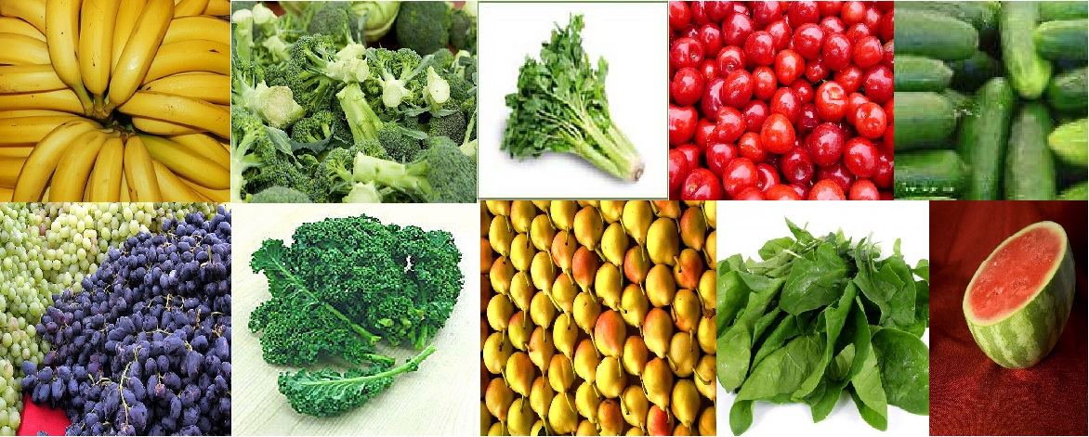
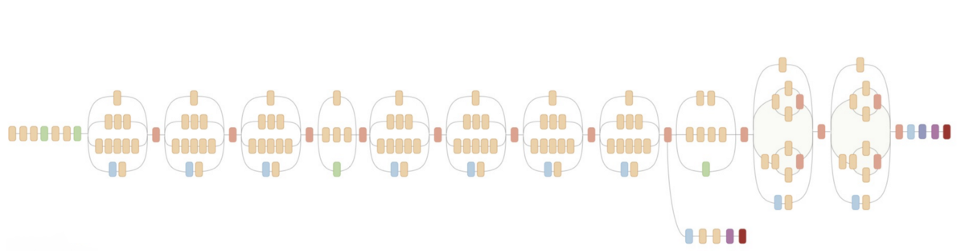
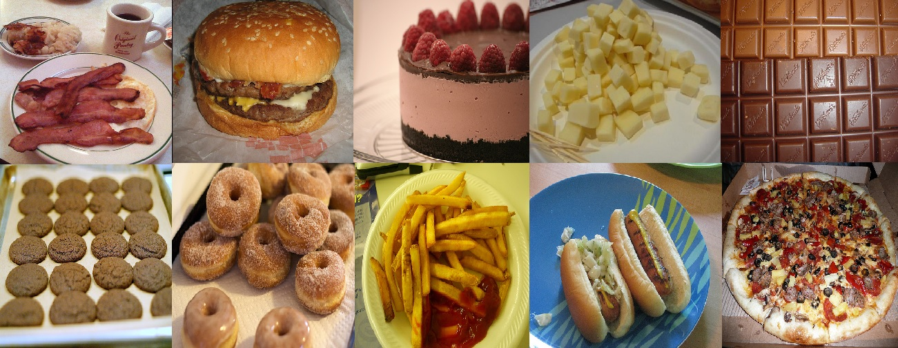
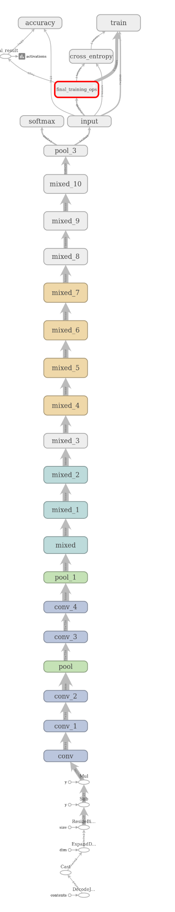
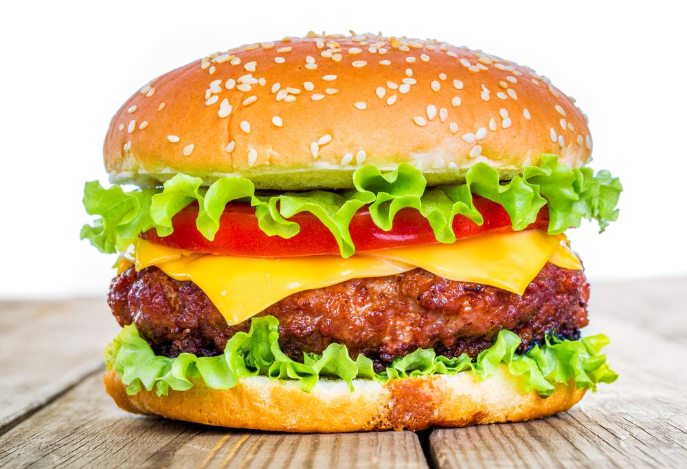
Twitter Image Classification
Predictive Model Building
Trained model
Trained Label files
Output: Trained Model
Input: ImageNet Data
Retraining final layer of Inception v3
Recognition
High Level:
unhealthy (score = 0.85185)
healthy (score = 0.14815)
Top 5/23:
burger (score = 0.54457)
frenchfries (score = 0.09466)
bacon (score = 0.03273)
donuts (score = 0.02944)
cakes (score = 0.02524)
Input: Twitter Image
Trained Model
Output: Recognition Result

Slide 11
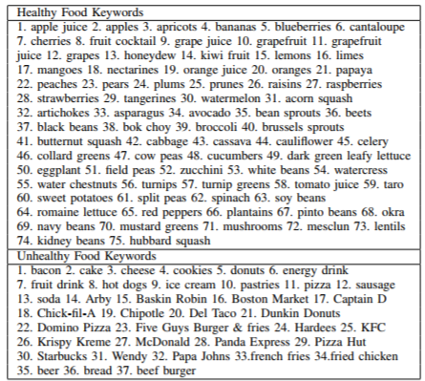
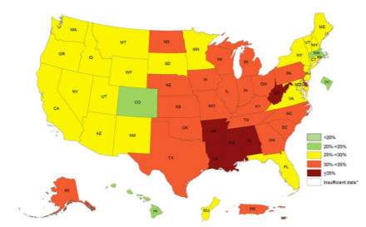
Healthy Tweet & Obesity Prevalence Map
Region | Adult Population | State
Green | 20%<=OP<25% | Colorado, Hawaii, Massachusetts, DC
Yellow | 25%<=OP<30% | 22 States and Guam
Orange | 30%<=OP<35% | 20 states and Puerto Rico, Virgin Islands
Red | 35% or more | Alabama, Arkansas, Louisiana ,Mississippi, West Virginia
Green Region | Orange Region | Red Region | Yellow Region
Colorado Massachusetts District of Columbia Hawaii | Illinois Kansas North Carolina Texas Missouri Ohio | Mississippi Louisiana Alabama Arkansas | Washington California New York Arizona Minnesota Utah
Tweets collected on Healthy/Unhealthy Keywords
USDA MyPlate
USDA Standardized Recipe
https://www.cdc.gov/obesity/data/prevalence-maps.html
Tweets collected on location using CDC Obesity Prevalence Map

Slide 12
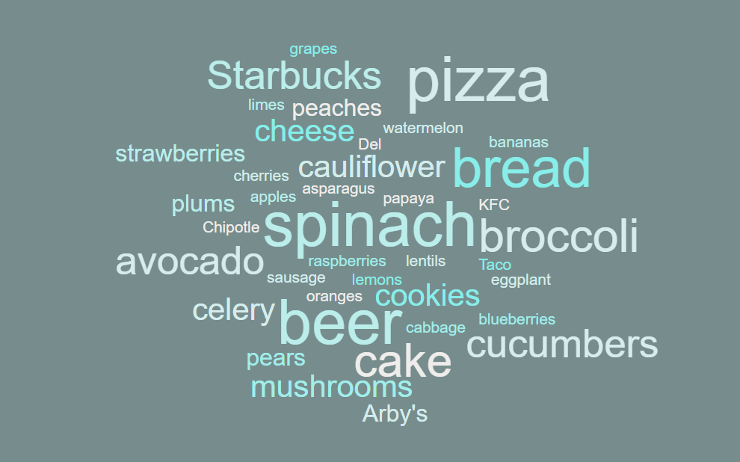
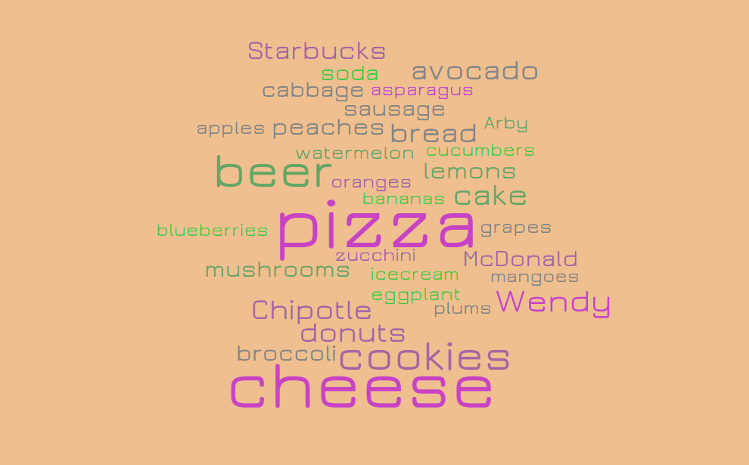
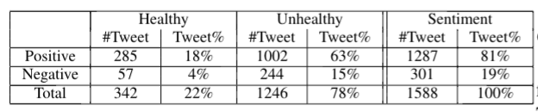
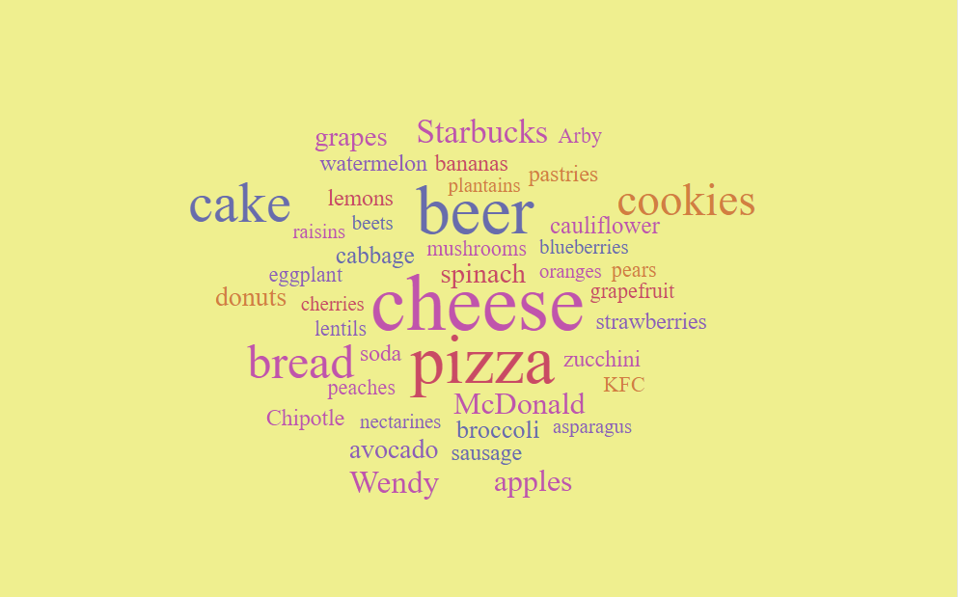
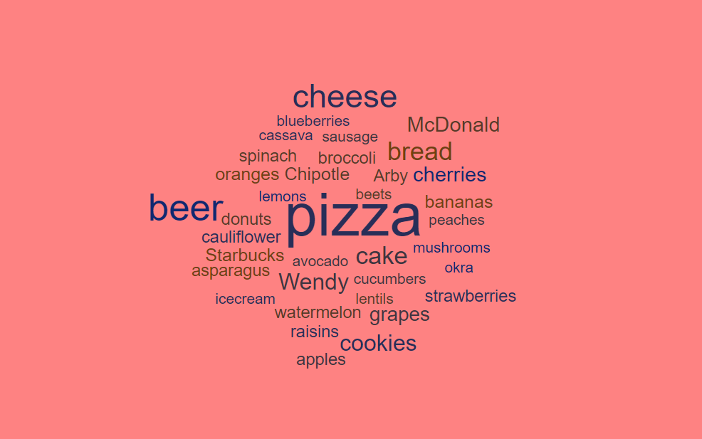
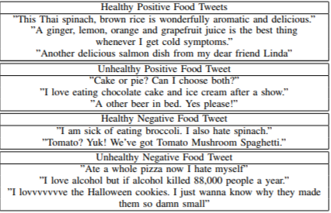
Tweet Analysis
Tag Cloud for Tweet Analysis on CDC Obesity Prevalence Map
Food Tweets Sentimental Analysis

Slide 13
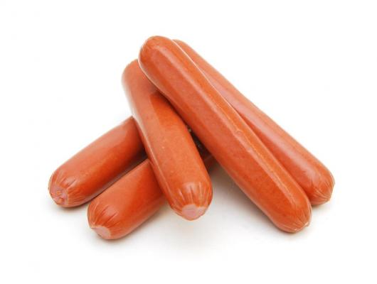
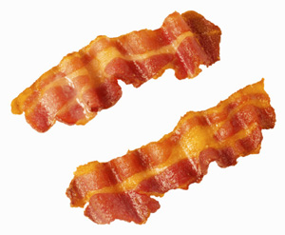
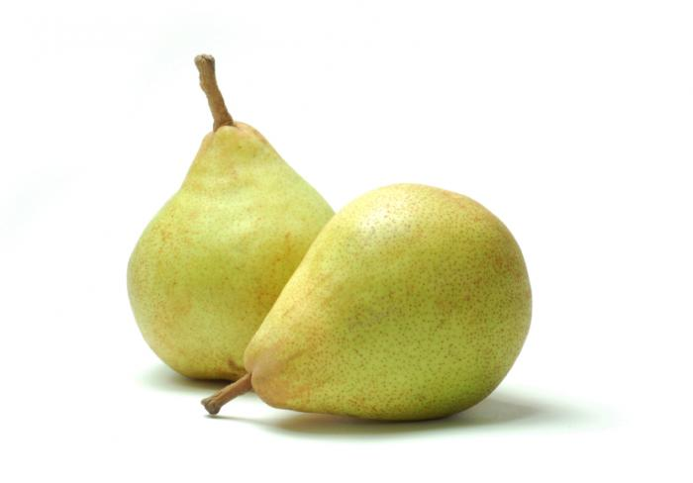
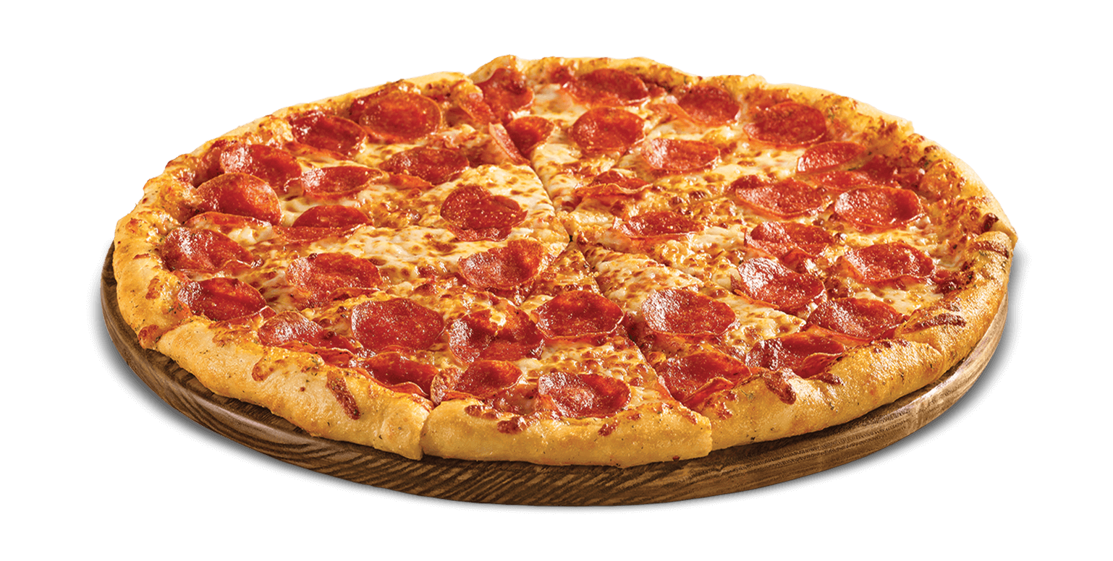
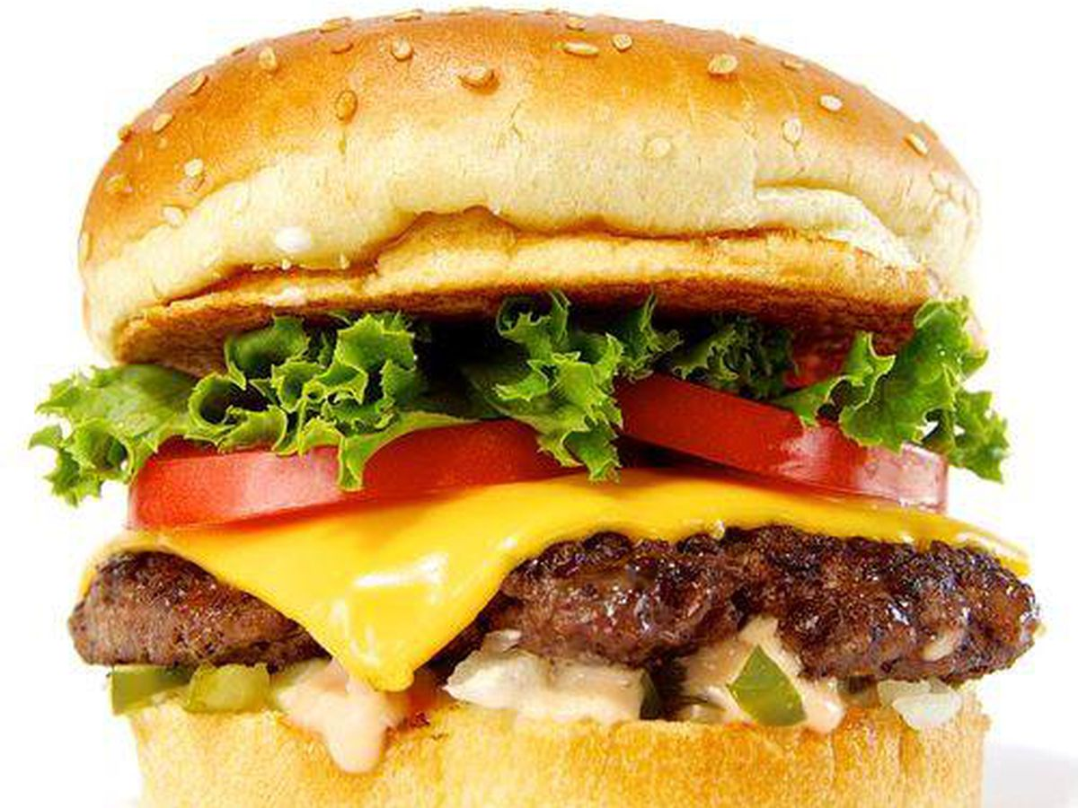
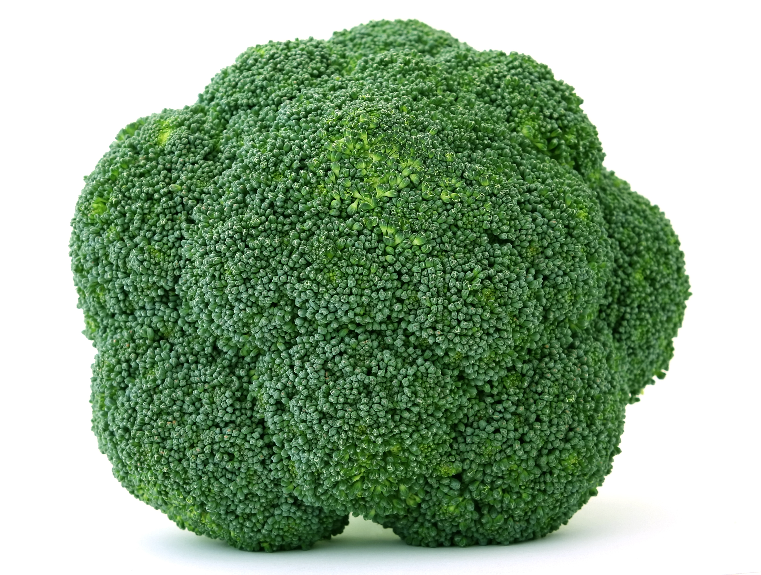
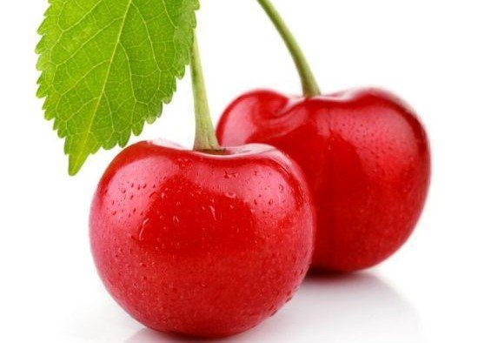
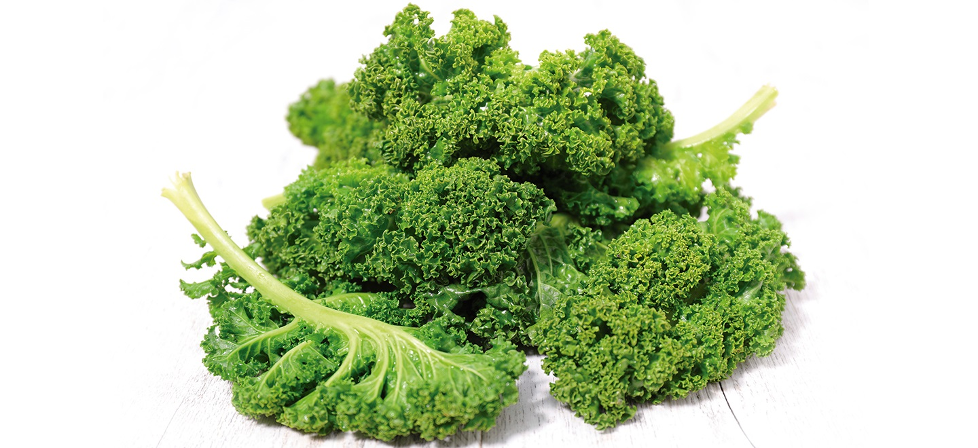
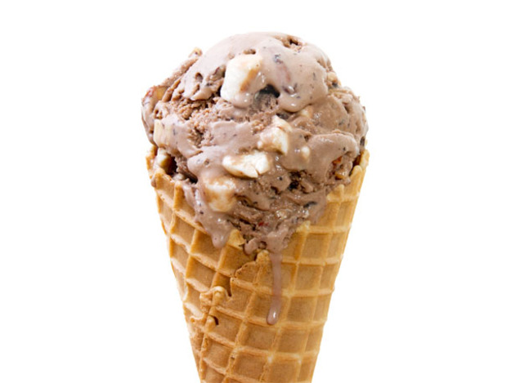
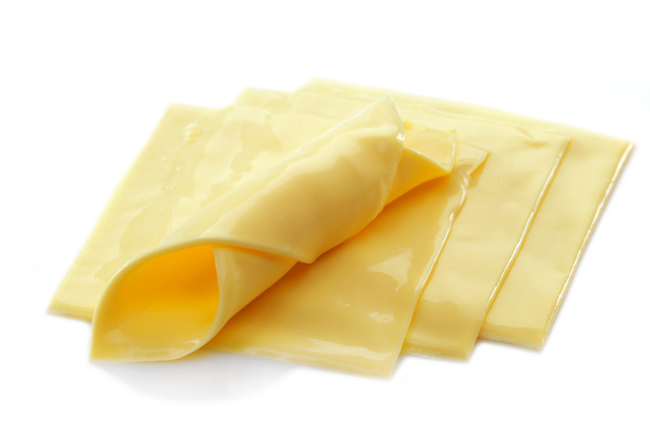
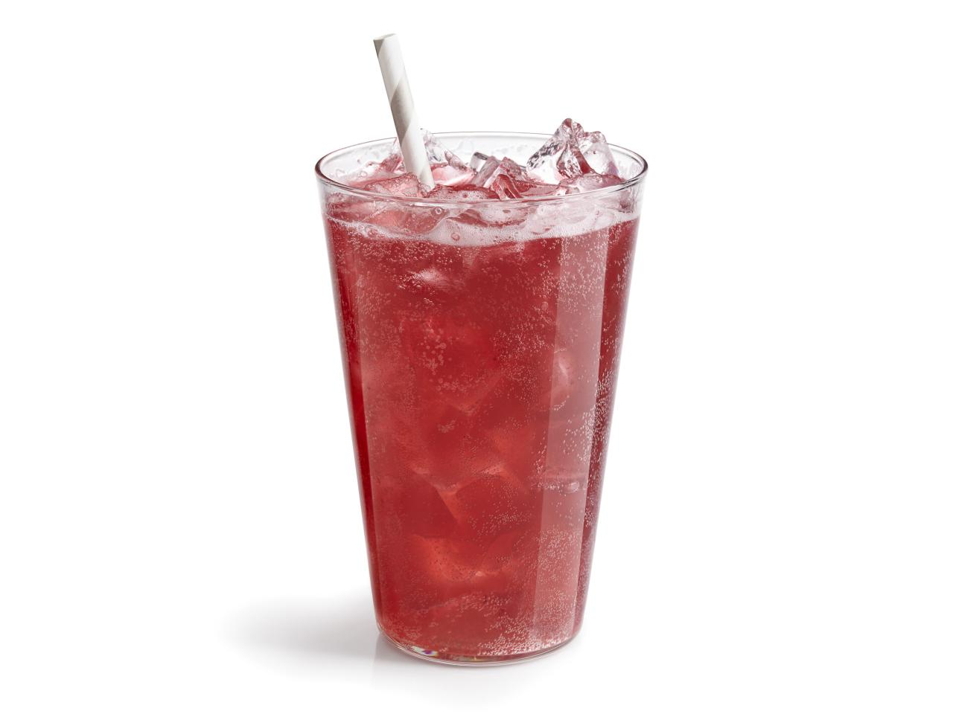
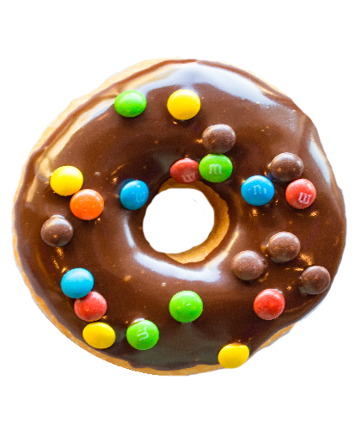
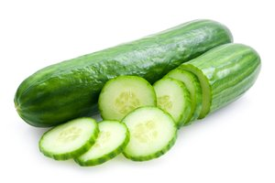
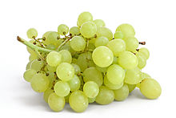
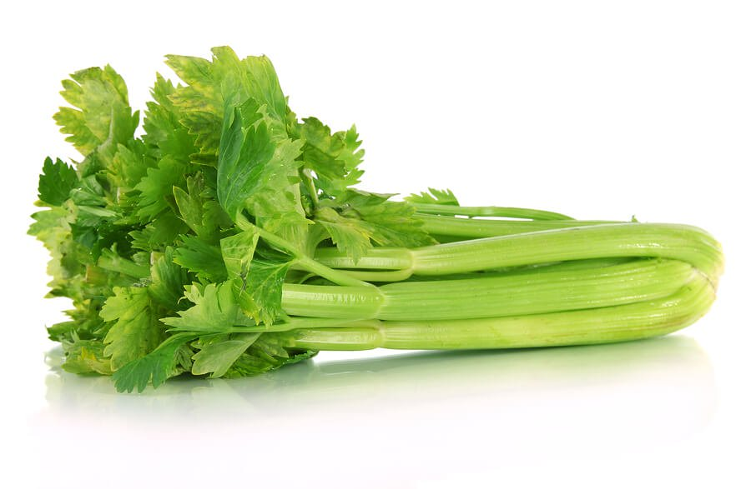
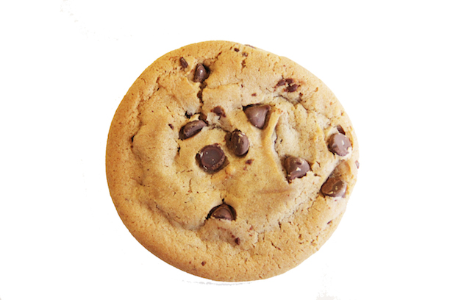
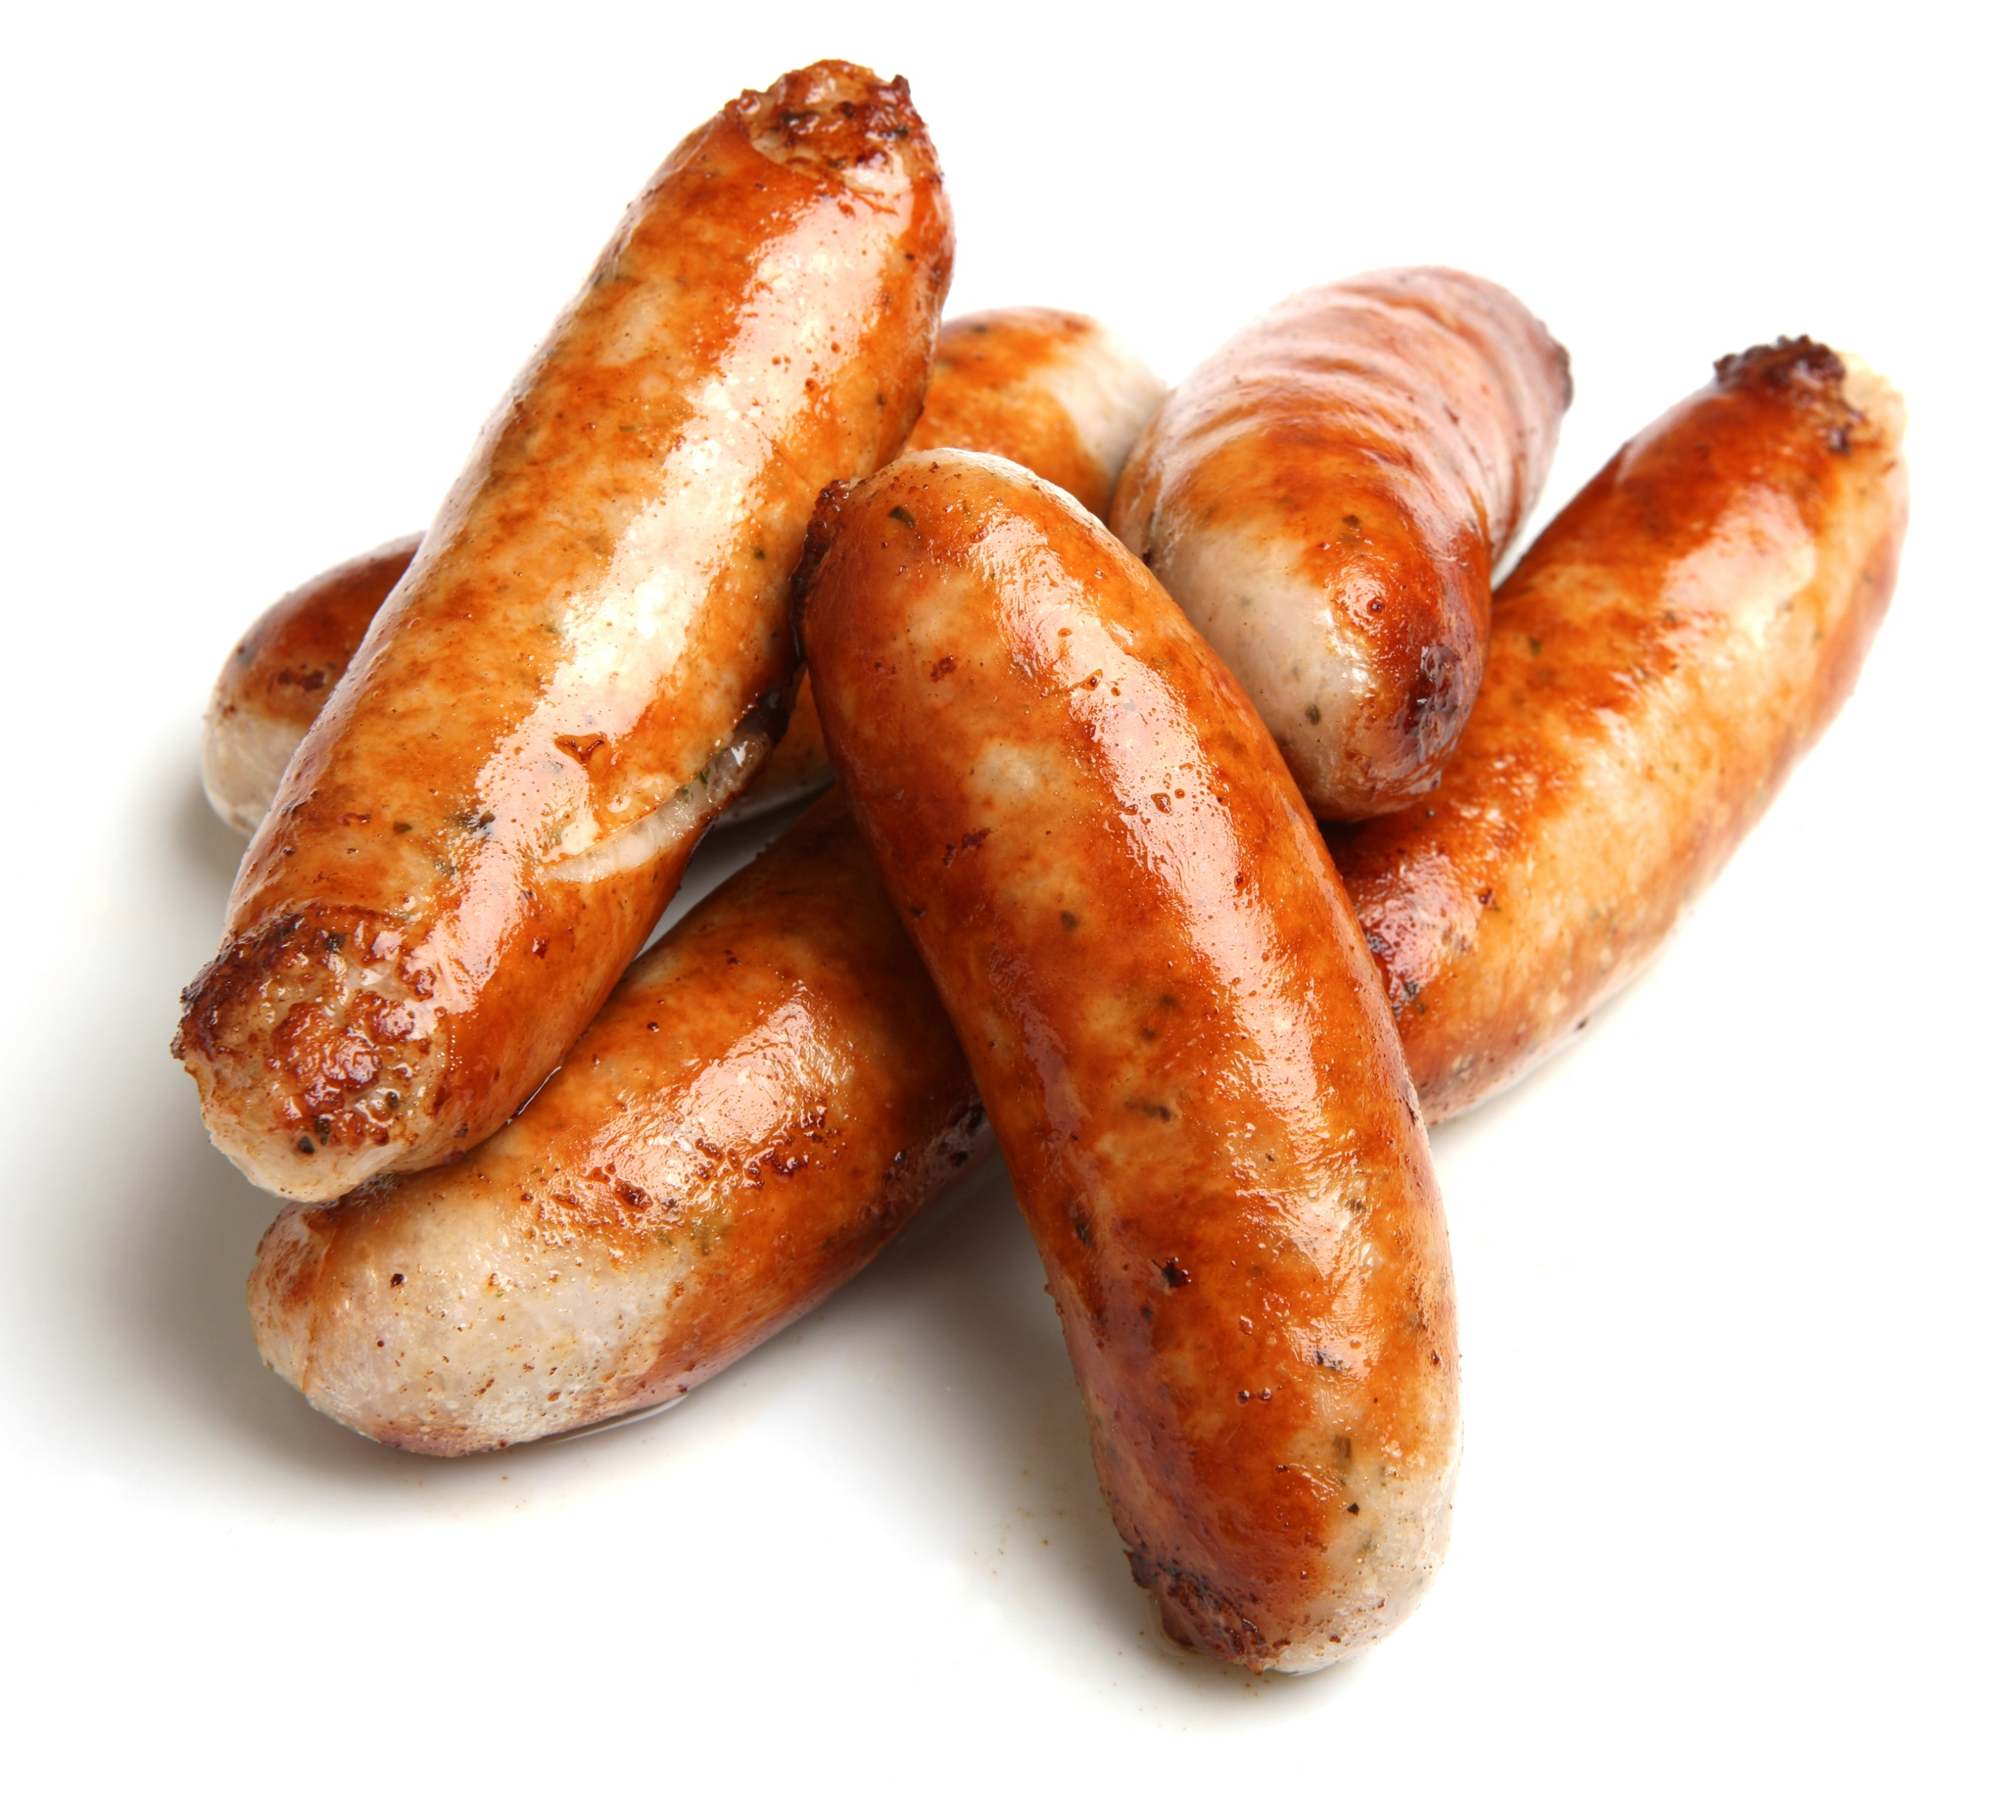
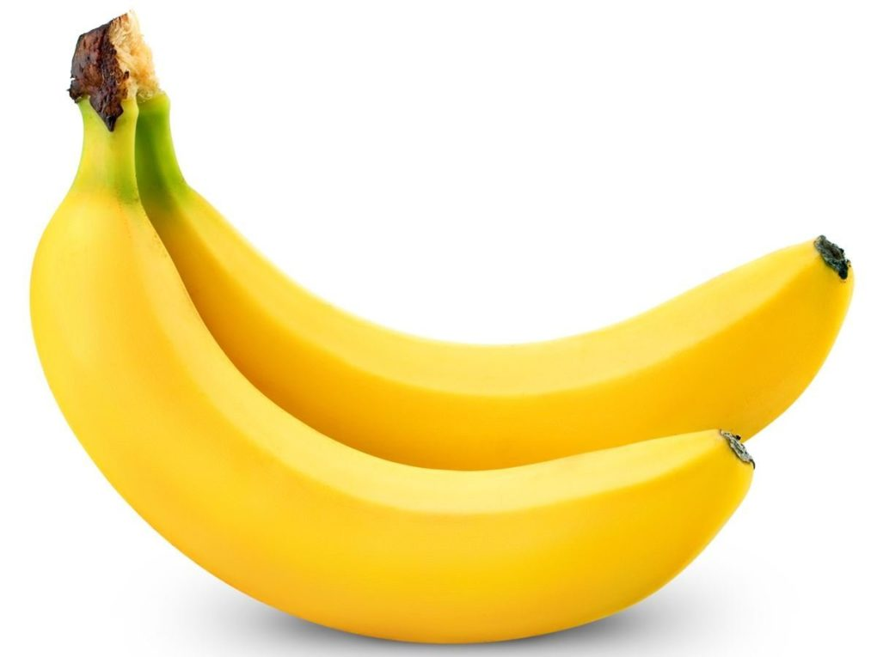
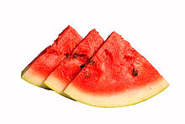




Food Image Hierarchy
FOOD
Unhealthy
Healthy

Slide 14
Food Image Classification
Top Level Food Classification
Bottom Level Food Classification
Healthy/Unhealthy Food & Fast/Non-Fast Food
Healthy/Unhealthy Food (23 Categories)
Categories | #Images | Categories | #Images
Healthy | 12,873 | Fast Food | 11,859
Unhealthy | 13,165 | Non-fast food | 11,166
Total | 26,038 | Total | 23,025
Accuracy
Train Accuracy | 97% | Train Accuracy | 94%
Test Accuracy | 95.8% | Test Accuracy | 96.8%
Validation Acc. | 98% | Validation Acc. | 96%
Cross entropy | 0.105 | Cross entropy | 0.1
Healthy Food #Images |  |  |  |  | Unhealthy Food #Images
pears | 1279 | Water melon |  | 1353 | bacon | 591 | hot dogs |  | 1257
grapes | 1684 | cherries |  | 1337 | sausages | 79 | donuts |  | 1314
bananas | 1409 | cucumbers |  | 1268 | ice cream | 994 | cheese |  | 759
spinach |  | 1108 |  |  | cakes | 69 | pizza |  | 1289
kale |  | 1191 |  |  | soda | 1361 | cookies |  | 1242
celery |  | 1020 |  |  | burger | 1373 | Chocolate |  | 1350
broccoli |  | 1224 |  |  | French fries |  | 1487
Total |  | 12,873 |  |  | Total |  | 13,165
Accuracy
Train Accuracy |  |  | 76% |  | Test Accuracy |  |  | 78.30%
Validation Acc. |  |  | 77% |  | Cross entropy |  |  | 1.24

Slide 15


Multi Food Recognition
Healthy Food Multi-Object Recognition
Fast Food Multi-Object Recognition

Slide 16
Conclusion
Big Data Analytics (BiDAF) framework is
effective in identifying “emotional eating” on social media.
good at multi food recognition in social images using Deep Learning
Validated the tweet analysis with the Obesity Prevalence Map of the Centers for Disease Control & Prevention
Future Work
Integrated multi-modality (text model + image model) for comprehensive interpretation of tweet messages.
Large scale and long-term tweet analysis for finding the correlation between obesity and tweet food emotion

Slide 17
Questions?

